Slide 1
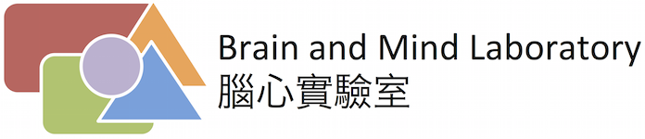









Using Machine Theory of Mind to Learn Agent Social Network Structures from Observed Interactive Behaviors with Targets
Yun-Shiuan Chuang
Hsin-Yi Hung
Yi-Chuang Lin
Yen-Ling Lai
Yun-Shiuan Chuang, Hsin-Yi Hung, Edwinn Gamborino, Joshua Goh, Tsung-Ren Huang, Yu-Ling Chang, Su-Ling Yeh, Li-Chen Fu
National Taiwan University
2020, 29th IEEE Int. Conf. Robot Human Interactive Comm. (RO-MAN), 1013-1019
Chinese Psychological Society, July 2022

Slide 2



Smooth Social Behavioral Interactions Involve Theory of Mind
Bob: “Hey Siri, I just got fired.”
Here are some websites I found about getting fired.
!?
I am sorry to hear that.
Maybe we can talk to someone about it.

Slide 3

Social Behavior Interactions Depend on Social Network Structure
++
Father
Mother
We could talk to Alice.
+
++
+
++
Bob
Bob
-
Alice
+
~
Kate

Slide 4


Social Network Structure Drives Social Behavioral Interactions
++
Father
Mother
Bob
Mother
+
++
+
++
Bob
-
Alice
Bob
Alice
+
~
Bob
Kate
Kate

Slide 5
Social Network Structure Inferred from Social Behavior Interactions
++
Bob
Mother
Father
Mother
+
++
+
++
Bob
Alice
Bob
-
Alice
+
~
Bob
Kate
Kate

Slide 6
Social Network Structure Knowledge Smooths Social Interactions
++
Father
Mother
We could talk to Mom about it but let’s not let Alice know.
+
++
+
++
Bob
-
Alice
Bob
+
~
Kate

Slide 7
Simulating Hidden Social Structures that Drive Social Approach Behavioral Trajectories in Gridworld
##############
# # # #
# # # #
## #
# # O # #
# # #
# #
# M ##
# # P #
# N # A##
# #
# #
## # # #
##############
##############
# # # #
# # # #
## #
# # O # #
# # #
# #
# M ##
# # P #
# N # A ##
# #
# #
## # # #
##############
##############
# # # #
# # # #
## #
# # O # #
# # #
# #
# M ##
# # P #
# N # A ##
# #
# #
## # # #
##############
##############
# # # #
# # # #
## #
# # O # #
# # #
# #
# M ##
# # P #
# N # A ##
# #
# #
## # # #
##############
##############
# # # #
# # # #
## #
# # O # #
# # #
# #
# M ##
# # PA #
# N # ##
# #
# #
## # # #
##############
##############
# # # #
# # # #
## #
# # O # #
# # #
# #
# M A ##
# # P #
# N # ##
# #
# #
## # # #
##############
##############
# # # #
# # # #
## #
# # O # #
# # #
# A #
# M ##
# # P #
# N # ##
# #
# #
## # # #
##############
##############
# # # #
# # # #
## #
# # O # #
# # A #
# #
# M ##
# # P #
# N # ##
# #
# #
## # # #
##############
##############
# # # #
# # # #
## #
# # O A # #
# # #
# #
# M ##
# # P #
# N # ##
# #
# #
## # # #
##############
 |  | M | N | O | P
 | u_{i.s*} | g_{i.s1} | g_{i.s2} | g_{i.s3} | g_{i.s4}
A | a_{i=1} | 17 | 16 | 19 | 14
S | a_{i=2} | 8 | 10 | 12 | 11
 | a_{i=n} | u_{i.s1} | u_{i.s2} | u_{i.s3} | u_{i.s4}
##############
# # # #
# # # #
## #
# # OA # #
# # #
# #
# M ##
# # P #
# N # ##
# #
# #
## # # #
##############
g_{s1}
u_{i.s1}
g_{s4}
u_{i.s4}
a_{i}
g_{s2}
u_{i.s2}
u_{i.s3}
…
…
…
…
…
g_{s3}
a_{i}: i^{th} agent.
g_{i.s}: s^{th} target of i^{th} agent.
u_{i.s}: Social utility of s^{th} target for i^{th} agent.
d_{i.s.j}: Smallest no. of steps between s^{th} target and i^{th} agent in j^{th} Gridworld.
Final target of j^{th} Gridworld g*_{j} = arg min(u_{i.s*} - d_{i.s*.j})
Notes:
We first come up with this social preference structure.
The numbers represents the degree of favoring this agent. Which means, in this example, agent E scored 10 points in agent S’s ranking, while agent F only scored 2 points in agent S’s ranking.
Imagine in a real interaction scene. If we meet someone we like, no matter virtually or physically, we may get closer to each other.
So in this case, if S, E and F is in the same space, S will probably approach E rather than approaching F.

Slide 8
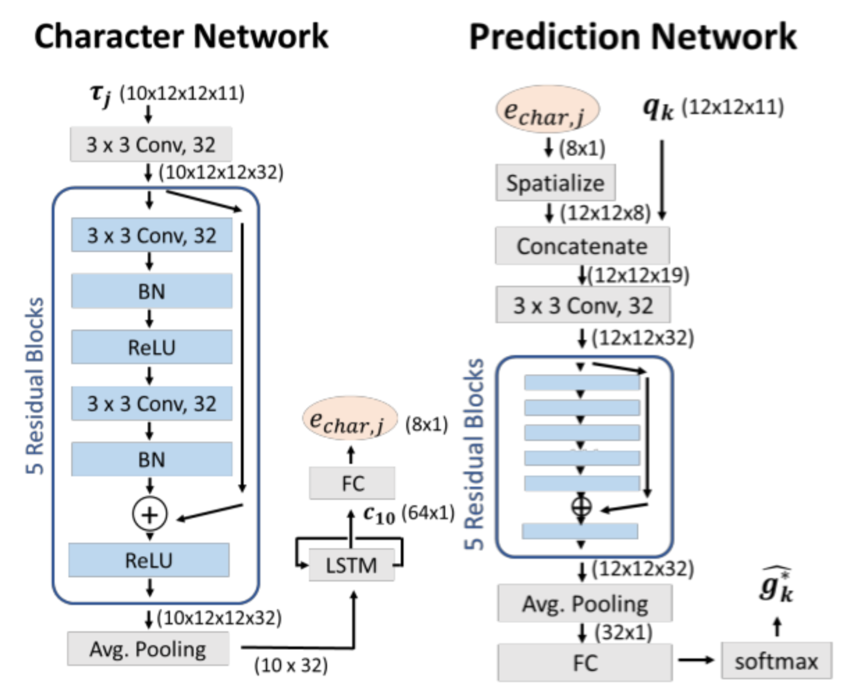
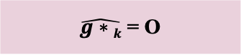
Theory of Mind network (ToMNet) Observes Social Trajectories, Learns Character, and Predicts Outcomes
Observed Gridworld trajectory, 𝜏_{j}
10,000 per agent x 30 agents = 30,000 training sets
##############
# #
# # #O #
# # #
# M # #
# #
# # #
# # N#
# ### #
# #
# A #
# ## # #
# P #
##############
Query trajectory
##############
# # # #
# # # #
## #
# # O # #
# # #
# #
# M ##
# # P #
# N # A##
# #
# #
## # # #
##############
$\hat{g∗k}$ = O
Convolutional
Neural
Network
Long
Short-Term
Memory
Rabinowitz et al. (2018). Proc. 35th Int. Conf. Machine Learning, 80, 4218-4227.
Notes:
The previous maze is one of our input simulation data, we generate total 10 thousand different mazes with the same set of social preference settings to train ToMnet.
(left)
After generating the simulation data set, we input the maze and the final goal together into ToMnet.
Note that without telling ToMnet the true social preference ranking, we trained Tomnet with mazes that represents these social preferences.
(right)
The structure showed in the right is a brief intro of ToMnet’s structure.
First, the input maze and the goal is fed into the char net. This char net arranges the input information, in other words, ToMnet is learning about what has just happened in this maze. This char net has two parts. The blue one is a kind of CNN, which digests the spatial information input. While the orange one is LSTM, this imports the temporal information, which is the movements of S by time.
(pred)
Then, after generating a summarize output from char net, the output will be fed into pred net. Pred net inputs another maze without the true goal. Together with the summarize output from the char net and the new maze, the Pred net outputs the predicted goal of the new maze. This output shows ToMnet’s thoughts about the recent social preference status.
This is the main structure of ToMnet.

Slide 9
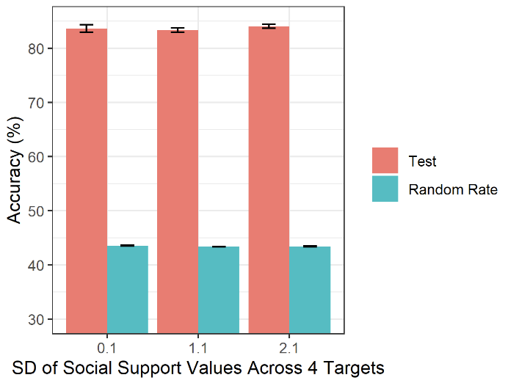
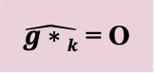
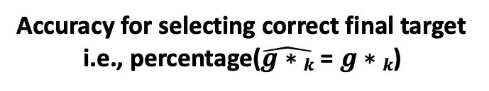
ToMNet Accurately Selects Final Social Target
Accuracy for selecting correct final target
i.e., percentage($\hat{g∗k}$ = $g∗k$)
 |  | M | N | O | P | SD
 | u_{i.s*} | g_{i.s1} | g_{i.s2} | g_{i.s3} | g_{i.s4}
A | a_{i=1} | 17 | 16 | 19 | 14 | 2.1
M
%
17
P
14
A
N
16
19
O
$\hat{g∗k}$ = O
Notes:
We first come up with this social preference structure.
The numbers represents the degree of favoring this agent. Which means, in this example, agent E scored 10 points in agent S’s ranking, while agent F only scored 2 points in agent S’s ranking.
Imagine in a real interaction scene. If we meet someone we like, no matter virtually or physically, we may get closer to each other.
So in this case, if S, E and F is in the same space, S will probably approach E rather than approaching F.

Slide 10
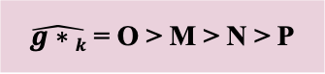
Theory of Mind network (ToMNet) Observes Social Trajectories and Represents Social Network
Observed Gridworld trajectory, 𝜏_{j}
10,000 per agent x 30 agents = 30,000 training sets
##############
# #
# O #
# #
# #
# #
# #
# M A N#
# #
# #
# #
# #
# P #
##############
Query trajectory
##############
# # # #
# # # #
## #
# # O # #
# # #
# #
# M ##
# # P #
# N # A##
# #
# #
## # # #
##############
$\hat{g∗k}$ = O > M > N > P
Convolutional
Neural
Network
Long
Short-Term
Memory
Notes:
The previous maze is one of our input simulation data, we generate total 10 thousand different mazes with the same set of social preference settings to train ToMnet.
(left)
After generating the simulation data set, we input the maze and the final goal together into ToMnet.
Note that without telling ToMnet the true social preference ranking, we trained Tomnet with mazes that represents these social preferences.
(right)
The structure showed in the right is a brief intro of ToMnet’s structure.
First, the input maze and the goal is fed into the char net. This char net arranges the input information, in other words, ToMnet is learning about what has just happened in this maze. This char net has two parts. The blue one is a kind of CNN, which digests the spatial information input. While the orange one is LSTM, this imports the temporal information, which is the movements of S by time.
(pred)
Then, after generating a summarize output from char net, the output will be fed into pred net. Pred net inputs another maze without the true goal. Together with the summarize output from the char net and the new maze, the Pred net outputs the predicted goal of the new maze. This output shows ToMnet’s thoughts about the recent social preference status.
This is the main structure of ToMnet.

Slide 11
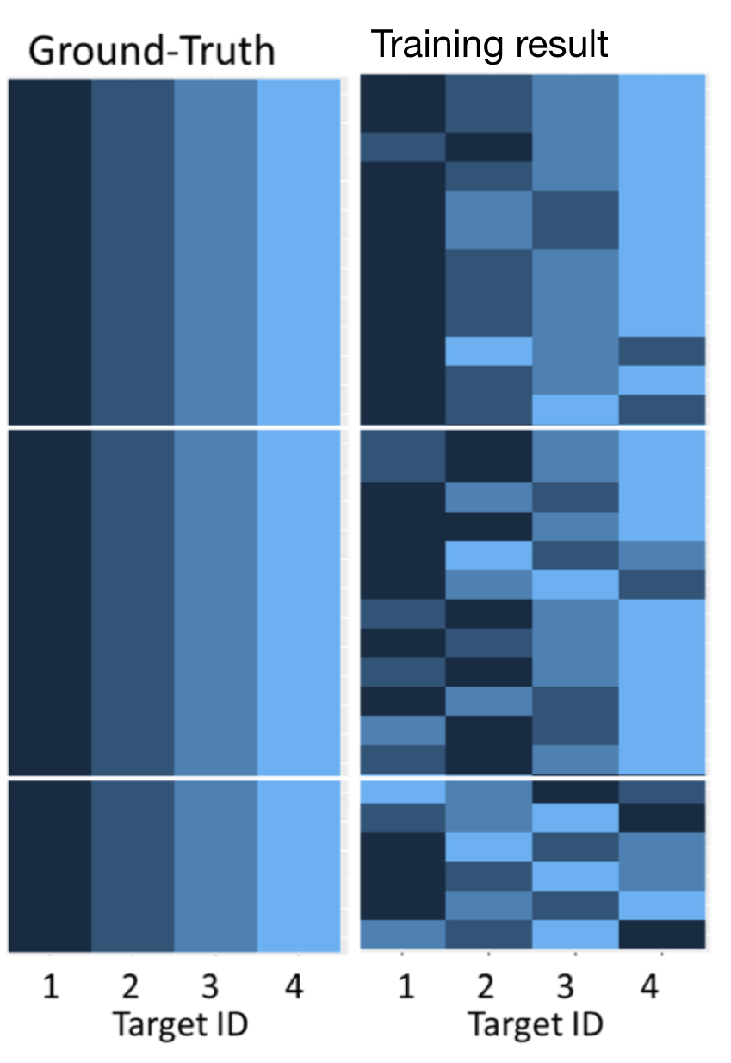
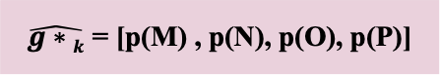
ToMNet Prediction Probabilities Represent Social Networks
Representational Similarity in Preference Ranks
ToMNet
 |  | M | N | O | P | SD
 | u_{i.s*} | g_{i.s1} | g_{i.s2} | g_{i.s3} | g_{i.s4}
A | a_{i=1} | 17 | 16 | 19 | 14 | 2.1
SD = 2.1
M
17
SD = 1.1
P
14
A
N
16
19
Kendall’s 𝜏 (Truth,ToMNet)
Wilcoxon Sign Rank
W = 390
p = 1.61 x 10⁻⁵
O
$\hat{g∗k}$ = [p(M) , p(N), p(O), p(P)]
SD = 0.1
p(O) > p(M) > p(N) > p(P)
Notes:
We first come up with this social preference structure.
The numbers represents the degree of favoring this agent. Which means, in this example, agent E scored 10 points in agent S’s ranking, while agent F only scored 2 points in agent S’s ranking.
Imagine in a real interaction scene. If we meet someone we like, no matter virtually or physically, we may get closer to each other.
So in this case, if S, E and F is in the same space, S will probably approach E rather than approaching F.

Slide 12

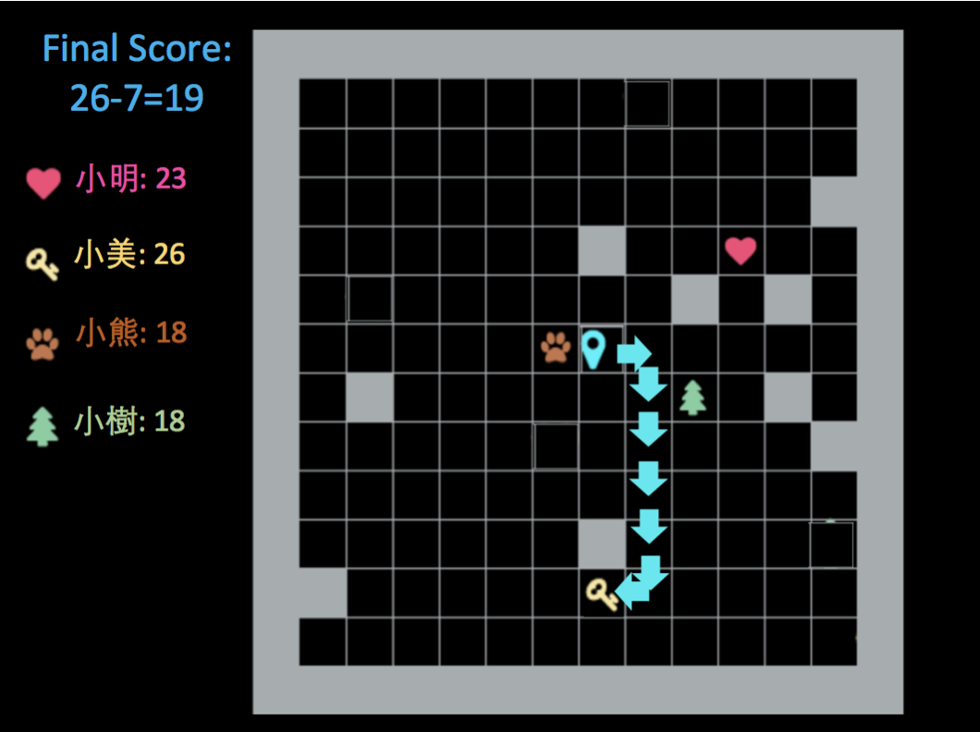
Estimating Real Human Social Networks from the Social Support Questionnaire (SSQ)
Sarason, Levine, Basham, & Sarason (1983). J. Pers. Soc. Psychol., 44(1), 127–139.
Notes:
Besides simulation data, we also conduct human experiment in a similar format.
In this experiment, we ask participants to play social games to record their behavior.
In the beginning of the game, we ask participants to fill up a modified Social support questionnaire based on the four agents the participant choose.
After constructing their social network structure, we ask them to play the social game based on this preference settings.

Slide 13
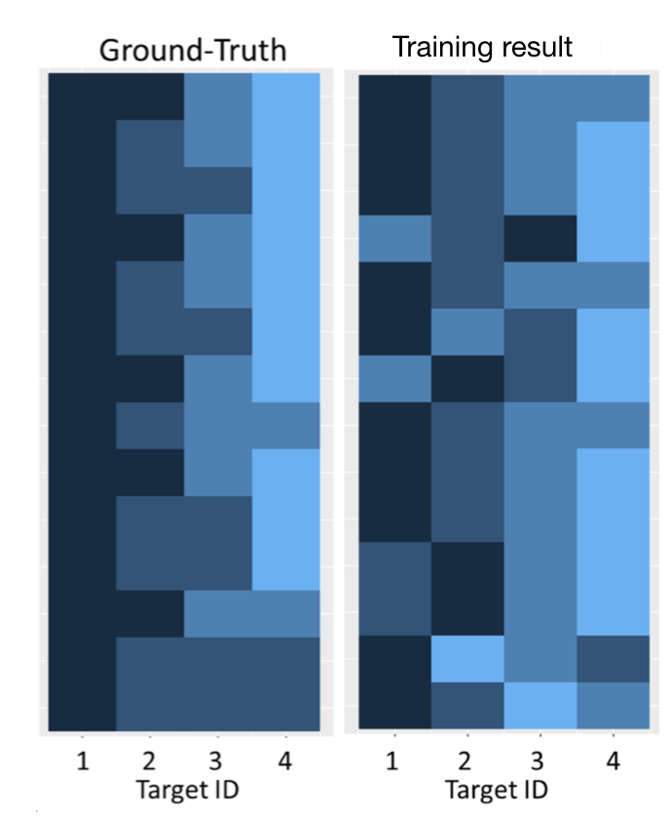
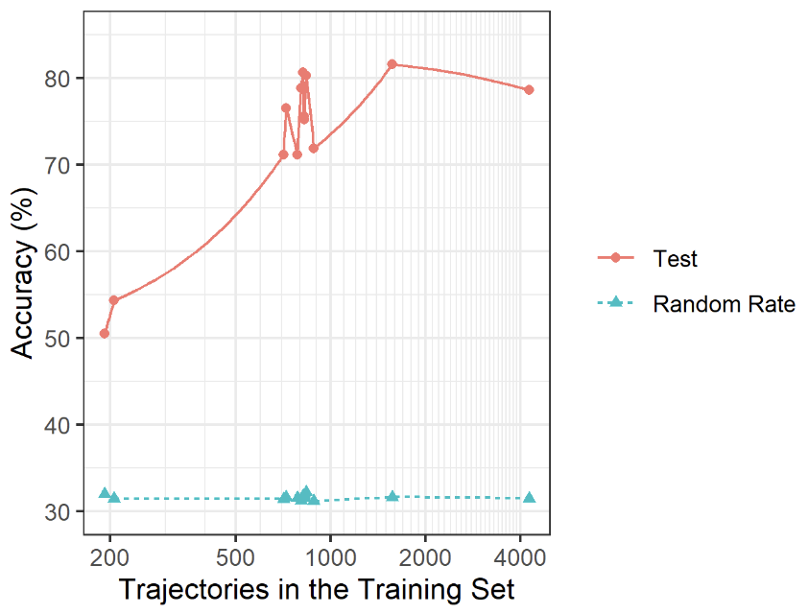
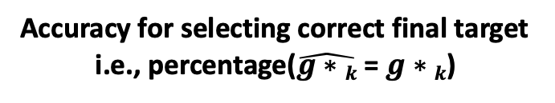
ToMNet Observes Human Game Behaviors, Accurately Predicts Social Target Outcomes, and Represents Human Self-Reported Social Networks
Accuracy for selecting correct final target
i.e., percentage($\hat{g∗k}$ = $g∗k$)
Representational Similarity in Preference Ranks
SD
ToMNet
7.07
n = 14
6.66
6.29
3.77
3.37
3.32
%
2.87
2.45
2.36
2.06
2.06
1.73
Kendall’s 𝜏 (Truth,ToMNet)
Wilcoxon Sign Rank
W = 105
p = .001
1.00
1.00
Notes:
In our human data training results, the left column represents the ground-truth of social preference structure generated from the social support questionnaire and the right column represents ToMnet’s training results, while each row means a different training set.
Same as the previous result:
The dark blue refers to the favorite agent S tends to approach, and the light blue refers to the least favorite agent, *note that in human data we’ve got ties in several social preference sets.
With the same methods quantifying simulation training results, we find ToMnet able to learn the social preferences embedded in the training sets.

Slide 14
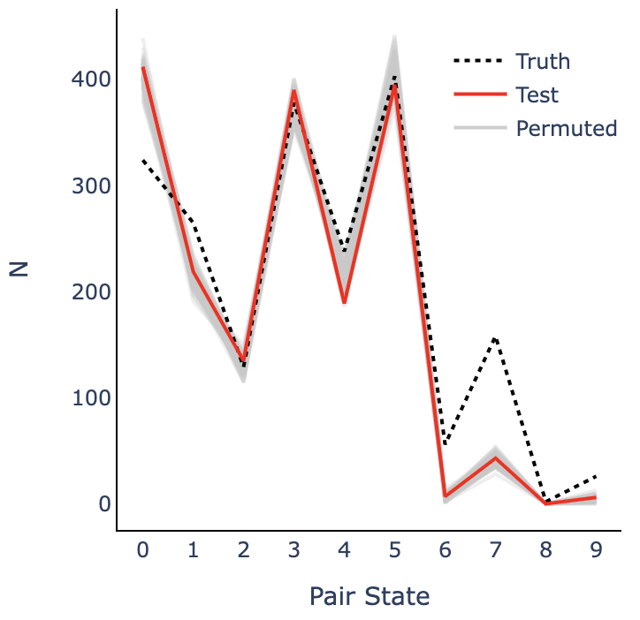
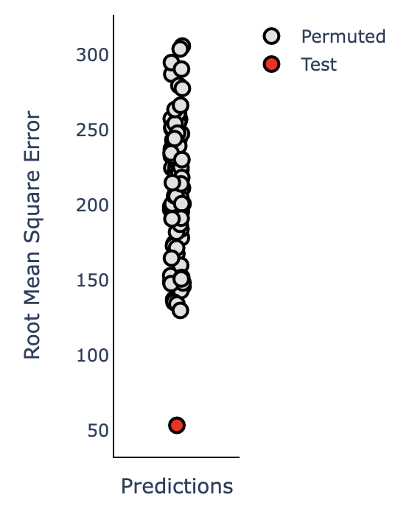
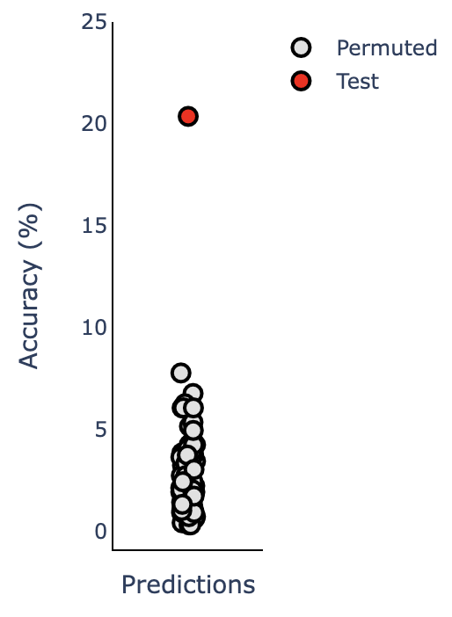
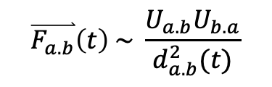
ToMNet 2.0: Towards More Complex Hidden Social Structures
##############
# #
# O #
# #
# #
# A #
# #
# #
# P #
# M #
# #
# N #
# #
##############
##############
# #
# #
# O #
# #
# A #
# #
# P #
# M #
# #
# N #
# #
# #
##############
##############
# #
# #
# #
# O #
# A #
# P #
# #
# M #
# N #
# #
# #
# #
##############
##############
# #
# #
# #
# O #
# PA #
# #
# M #
# N #
# #
# #
# #
# #
##############
##############
# #
# #
# #
# O #
# PA #
# #
# M N #
# #
# #
# #
# #
# #
##############
##############
# #
# #
# O #
# #
# PA #
# N #
# M #
# #
# #
# #
# #
# #
##############
##############
# #
# #
# O #
# P #
# A #
# M N #
# #
# #
# #
# #
# #
# #
##############
##############
# #
# #
# PO #
# #
# A #
# M N #
# #
# #
# #
# #
# #
# #
##############
##############
# #
# #
# PO #
# #
# A #
# MN #
# #
# #
# #
# #
# #
# #
##############
##############
# #
# #
# PO #
# A #
# #
# MN #
# #
# #
# #
# #
# #
# #
##############
g_{s1}
Pair States
u_{i.s1}
 | A | M | N | O | P
A |  | 0 | 1 | 2 | 3
M |  |  | 4 | 5 | 6
N |  |  |  | 7 | 8
O |  |  |  |  | 9
P
g_{s4}
u_{i.s4}
a_{i}
g_{s2}
u_{i.s2}
u_{i.s3}
g_{s3}
a_{i}
+
-
-
-
g_{s4}
+
g_{s1}
-
+
-
-
+
+
+
+
+
$$\overset{⃑}{F_{a.b}}\left(t\right) \sim \frac{U_{a.b}U_{b.a}}{d_{a.b}^{2}(t)}$$
+
-
+
+
g_{s3}
+
g_{s2}
-
Notes:
The left was the previous social preference structure settings. In this structure we could tell S preference to others (C,D,E,F)
But lacking of the information of other agent’s preference to each other.
However this is not the way how human hold social preferences, so we come up with a new social preference structure.
Here, the positive numbers stands for the like degree and the negative numbers stands for the dislike degree. This bi-directional social preference structure remains more realistic.
The positive numbers stands for the like degree and the negative numbers stands for the dislike degree.

Slide 15
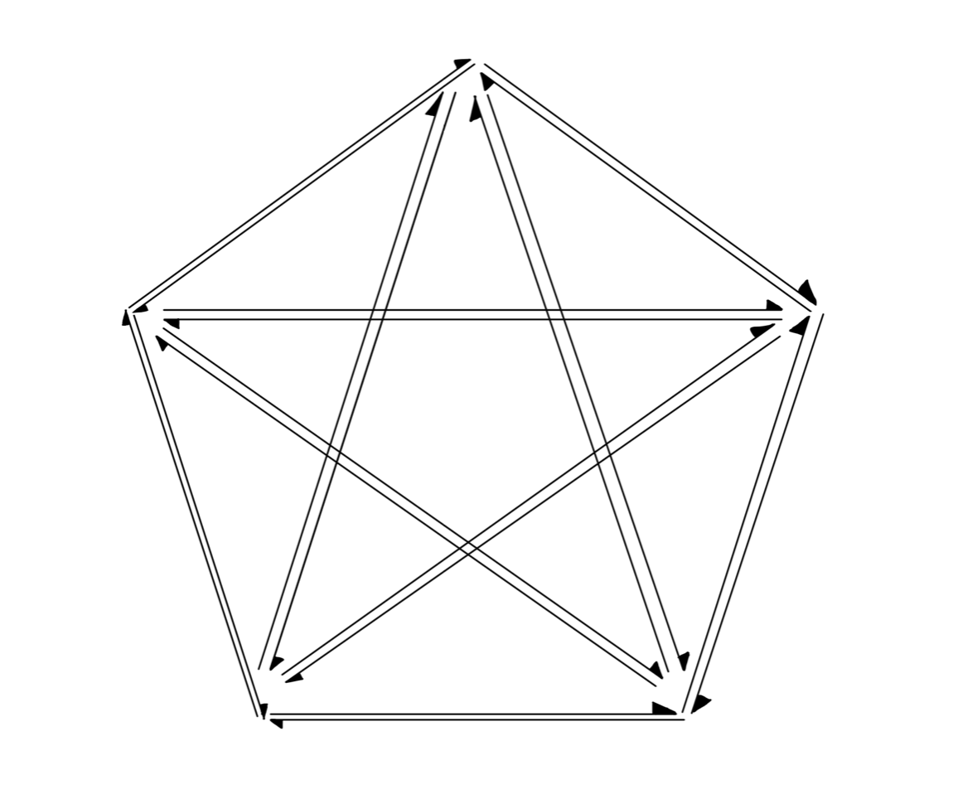

Estimating Real Human Social Networks in Role Playing Games
Merlin
?
?
-
?
Percival
Mortdred
?
-
+
?
+
?
?
?
?
Lancelot
Morgana
Notes:
The card game will divide participants into two groups.
Shown in the social structure, the red highlighted characters are the bad guys.
While the blue highlighted are the good guys.
Most participants don’t know others identity in the beginning.
But participants would come up with a guessed social structure by observing others behavior and statements during the game.
To collect participants forming their social preference structure, we collect the following behaviour during the card game.

Slide 16
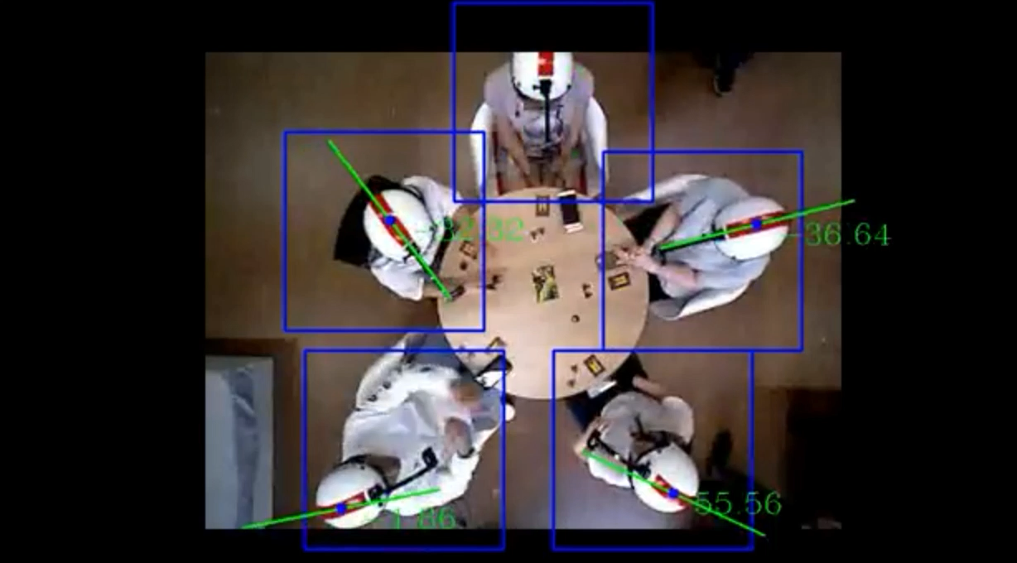
Behavioral Interactions During RPG Afford Social Preferences
Notes:
This is the Top-view of the game setting. We could see participants wearing helmets with marks on top of it. This is to help us analyze the head yaw angle.
We use this as an indicator of participants looking at each other’s time interval.

Slide 17
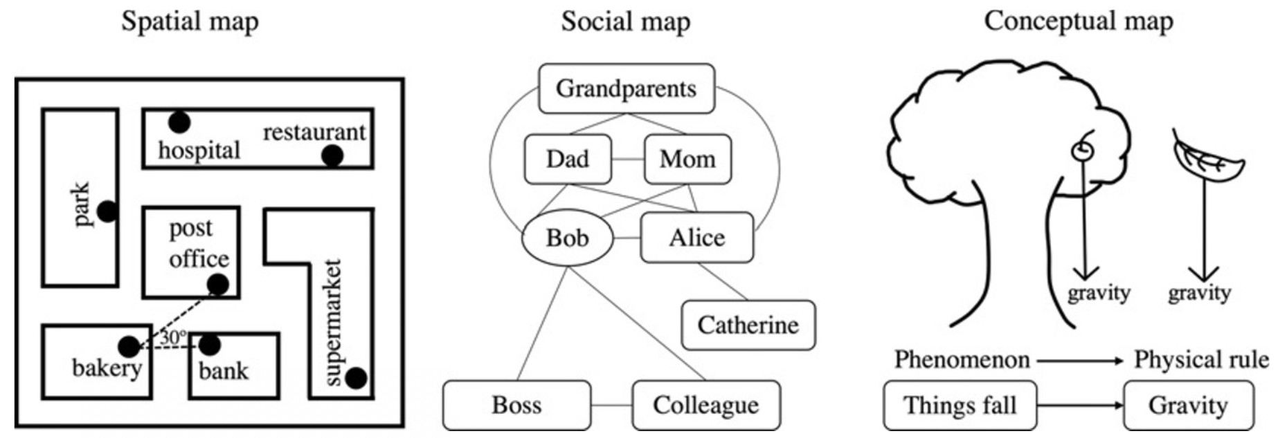
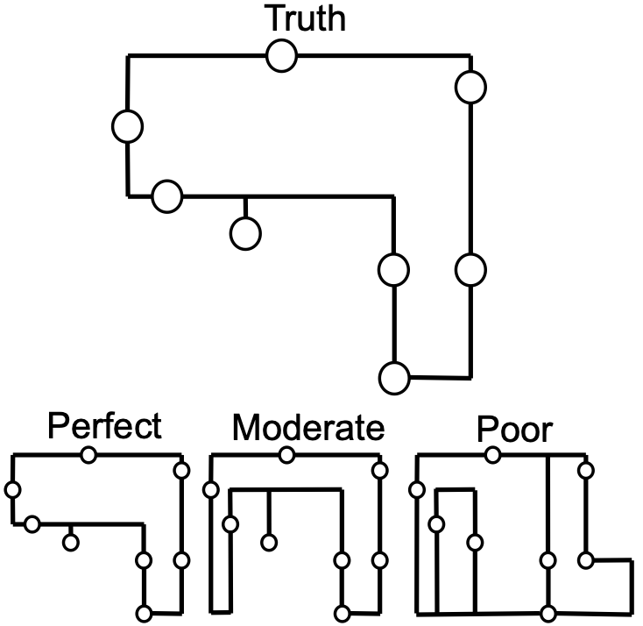
Environmental Associations as Computational Graphs in the Mind/Brain Neural Network
Goh, Hung, & Su (2019). A Conceptual Consideration of the Free Energy Principle in Cognitive Maps: How Cognitive Maps Reduce Surprise, Psych. Learning Motivation, 69, 205-240.

Slide 18
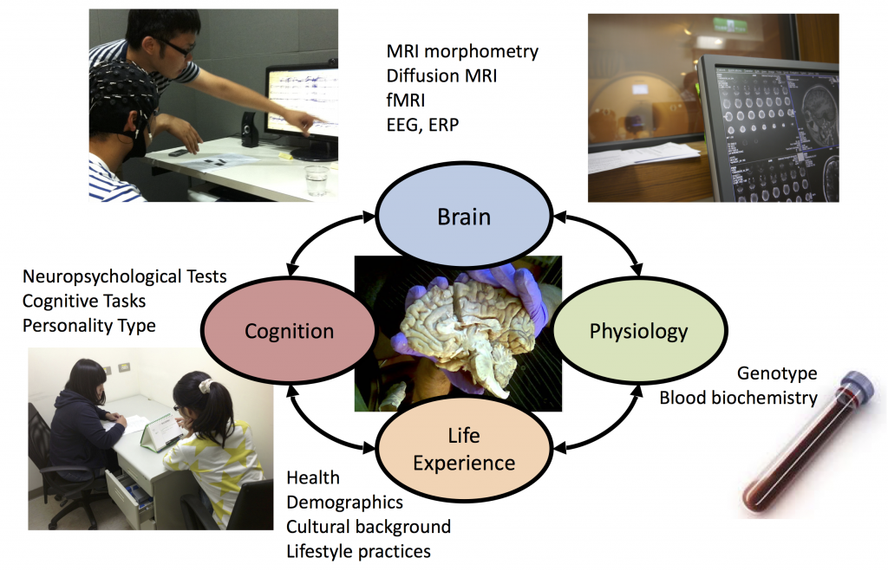
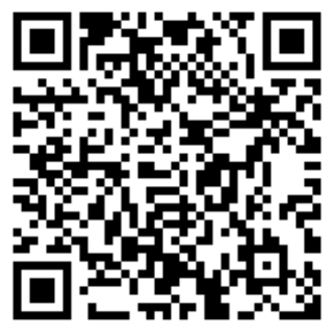



我們在招募受試者！
電信: ntubmlab@gmail.com
電話: +886-2-2321-9581
加入腦心實驗室LINE群組

